Slide 1



EARTH OBSERVATION SIMULATOR (EO-SIM): AN OPEN-SOURCE SOFTWARE FOR OBSERVATION SYSTEM DESIGN
Vinay Ravindra, Ryan Ketzner and Sreeja Nag
Bay Area Environmental Research Institute/
NASA Ames Research Center

Slide 2
CONTENTS
Introduction
Features
Orbit propagator
Coverage calculator
Contact opportunity calculator
Observation metrics calculator
Simulated Satellite Imagery
GUI
Demo
Applications
Future Work

Slide 3
INTRODUCTION
Project is pursued under the NASA ESTO AIST program funded DSHIELD project.
Mission design, analysis
Make an optimal configuration of space-resources in terms of orbit-selection, instrument-selection, etc. to meet end science-objective.
Develop optimal operation schedule to derive maximal benefit of the expensive, limited resources.
Examples of existing mission analysis tools: NASA GMAT, STK.
Provide for orbit propagation, coverage calculations (paid), inter-satellite/ground contact calculations.
EO-Sim is (not-just-another) mission analysis tool
Geared towards supporting science-driven observation scheduling of satellite constellations.
Lightweight and open-source, available on GitHub.

Slide 4
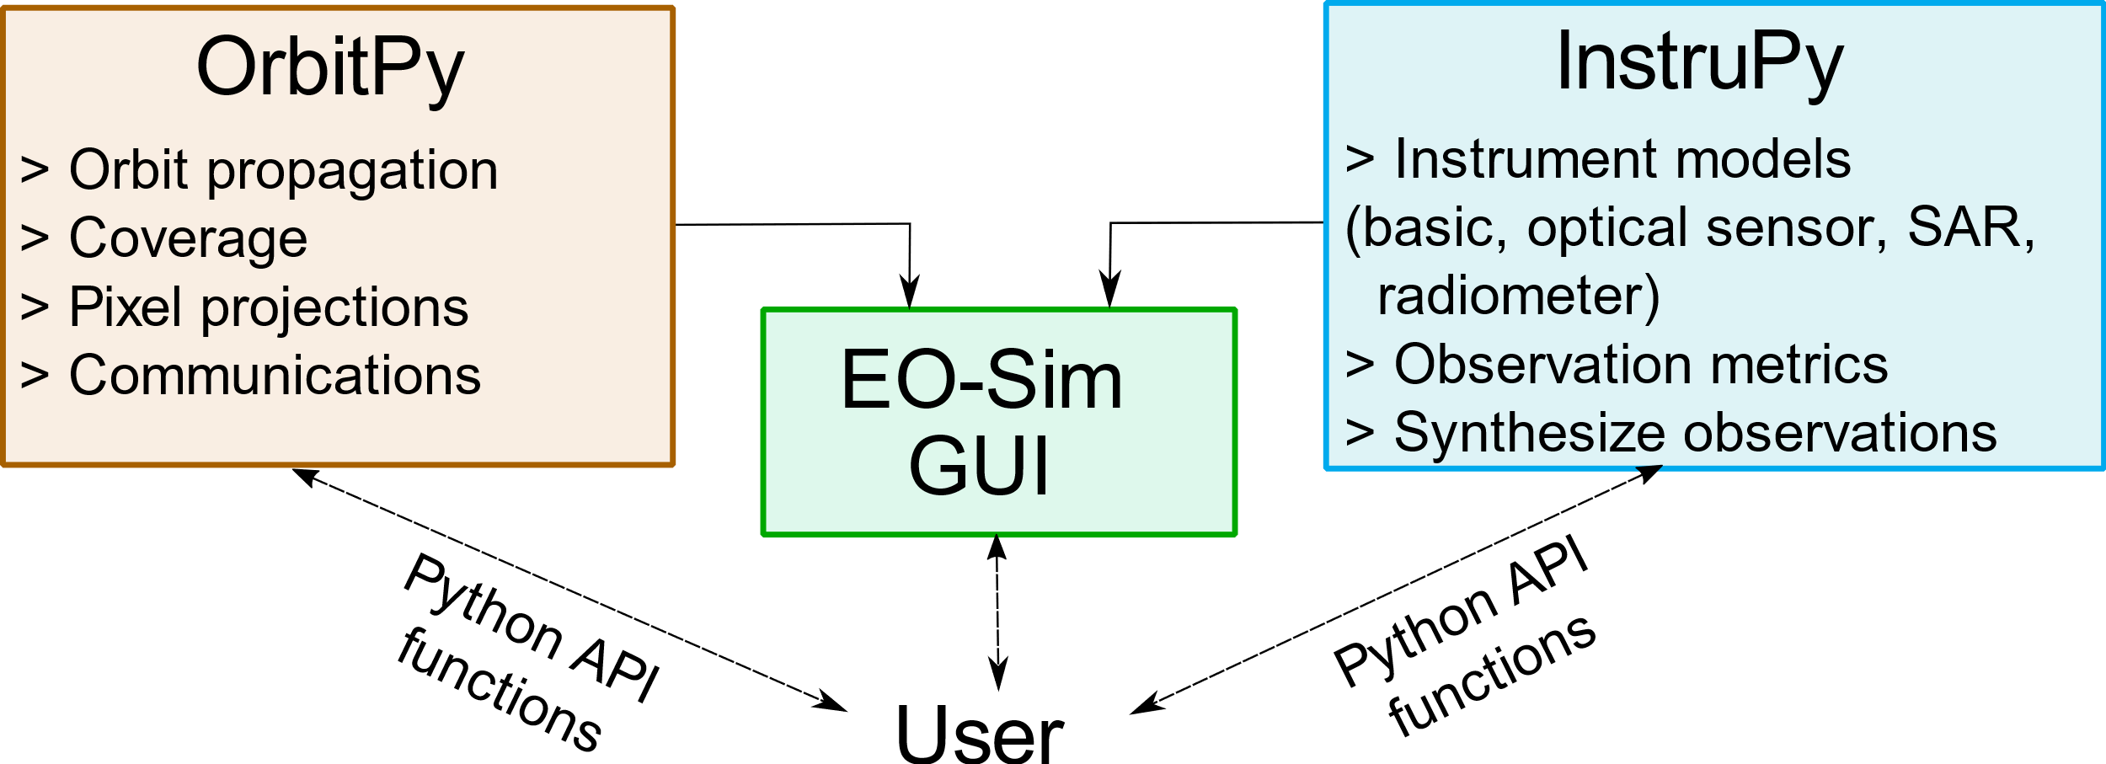
INTRODUCTION
Suite of Python packages: EOSim, OrbitPy and InstruPy
Beta version avail in a public Github repo under a permissive open-source license (Apache 2.0) (in Jan 2021)
https://github.com/EarthObservationSimulator/ (3 repositories EOSim, OrbitPy, InstruPy)
OrbitPy and InstruPy are the ‘engines’ while the ‘EO-Sim’ package provides a GUI.
Interface can be via the GUI or through Python API classes/function.
Notes:
Reason for splitting the framwork into multiple packages is to allow for modular development system. The two packages provide quite distinct functionalities.

Slide 5
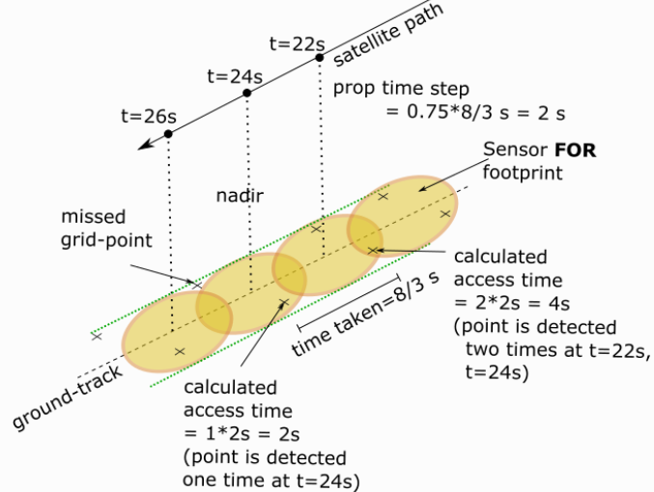
FEATURES: Orbit Propagator
Propagator: produces satellite states (position, velocity) at resolution of a propagation time-step throughout the mission from a given satellite initial-state.
Satellite-state at any time-instant allows to compute the relative geometry with respect to ground-locations to know if they can be imaged (coverage) and if so distances, angles at which the imaging can take place.
Propagator is a J2-analytical propagator which gives moderate accuracy of satellite-state prediction for 1~2 days.
Adding support to accept higher-fidelity orbit-data from other sources such as GMAT, STK.
Propagation time-step determination
Notes:
A small propagation time-step will result in fine-resolution data but increases the overall computation time. An acceptable value is selected based on the satellite sensor footprint size.

Slide 6
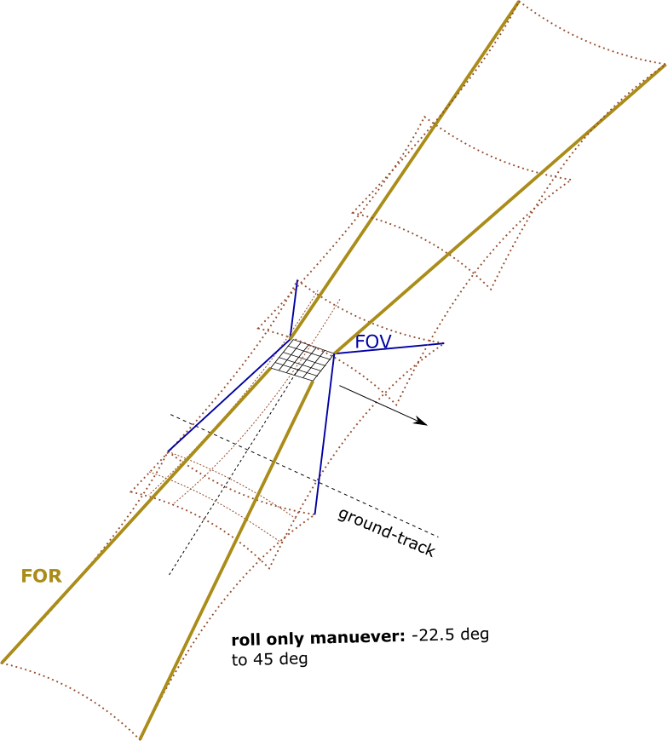
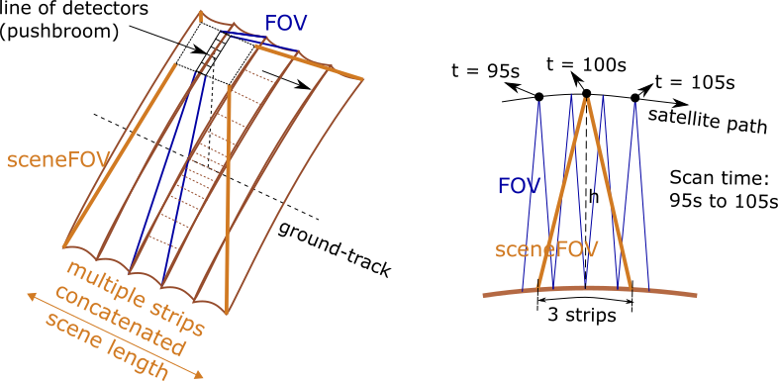
FEATURES: Coverage calculator
Coverage is the determination of locations that the satellite/sensor at an arbitrary time can potentially observe (i.e., fall-under sensor view).
Concepts of FOV vs Scene-FOV vs FOR
Room to specify arbitrary spherical polygon shapes to characterize the FOV.
Illustration of FOR concept
Illustration of sceneFOV concept

Slide 7
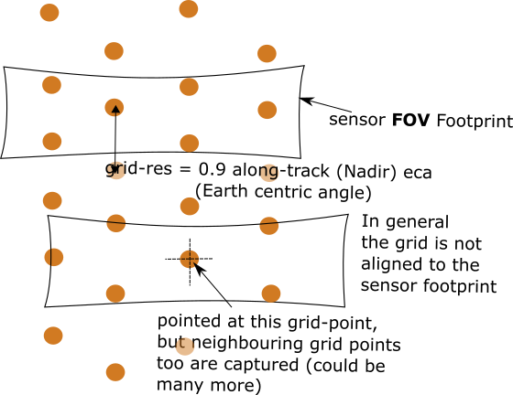
FEATURES: Coverage calculator
Three approaches:
Grid Coverage: Area of interest is represented by set of indexed discrete grid-points. At each time the access to these grid-points is tested and logged.
Pointing-Options Coverage: Set of pointing-options of the satellite/sensor are specified in the local-frame. The geocoords of the location at the intersection of the pointing-axis with Earth surface is calculated.
Pointing-Options with Grid Coverage: Like grid-coverage but done for multiple satellite/sensor orientations.
In the works: A (relatively) fast, accurate and robust coverage calculation algorithm (compared to the current state-of-art) to speed up calculations.
Illustration of impact of grid-resolution selection for a sensor footprint.
Grid-resolution ~ smallest footprint dimension

Slide 8
FEATURES: Contact opportunity calculator
Calculation of line-of-sight time-intervals between two satellites, or a satellite and a ground-station. Earth is the only occluding body considered.
In case of ground-stations a minimum elevation angle can be defined, below which contact is false.
Feature extended to calculate eclipse periods where the line-of-sight “contact” between a satellite and Sun is determined.
Results of these calculation can be readily used to simulate intersatellite communications using software such as dtnsim which uses Delay Tolerant Networking protocol to control intersatellite traffic.
https://github.com/msancheznet/dtnsim

Slide 9
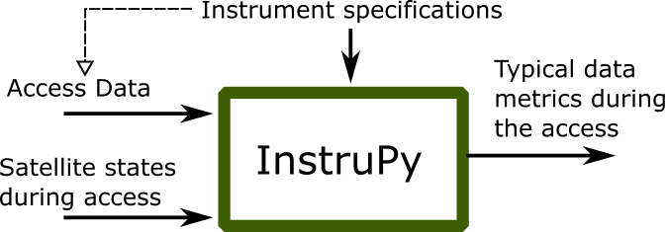
FEATURES: Observation metrics calculator
To calculate observation “quality” in terms of common metrics associated with the instrument.
The calculated metrics depend on both the instrument specifications and the satellite orbit states (to determine the observation geometry).
Helps to quantify the relative quality of images taken as various altitudes and off-nadir angles.

Slide 10
FEATURES: Observation metrics calculator
Instrument Type | Scan configurations | Metrics | Examples
Basic | -NA- | Range, elevation angle, incidence angle, Solar zenith | GLAS (LIDAR) on ICESAT, CATS on ISS
Passive-optical | Pushbroom | SNR, NEDT, spatial resolutions, Dynamic range | TIRS, OLI on Landsat-8
 | Whiskbroom |  | ETM+ onboard Landsat7
 | Matrix |  | PlanetScope PS2 onboard DOVE
Synthetic Aperture Radar | Stripmap, ScanSAR | NESZ, spatial resolutions, Incidence angle, Swath | SeaSat, PALSAR onboard JAXA’s ALOS, DLR’s TERRASAR-X, CSA’s RADARSAT
Radiometer Systems: Total-power, Dicke (unbalanced, balanced), Noise-adding | Fixed | Radiometric resolution, spatial resolutions, Swath, beam-efficiency | FMPL2
 | Cross-track |  | NIMBUS-5 ESMR, ATMS
 | Conical |  | SMAP, AMSRE

Slide 11
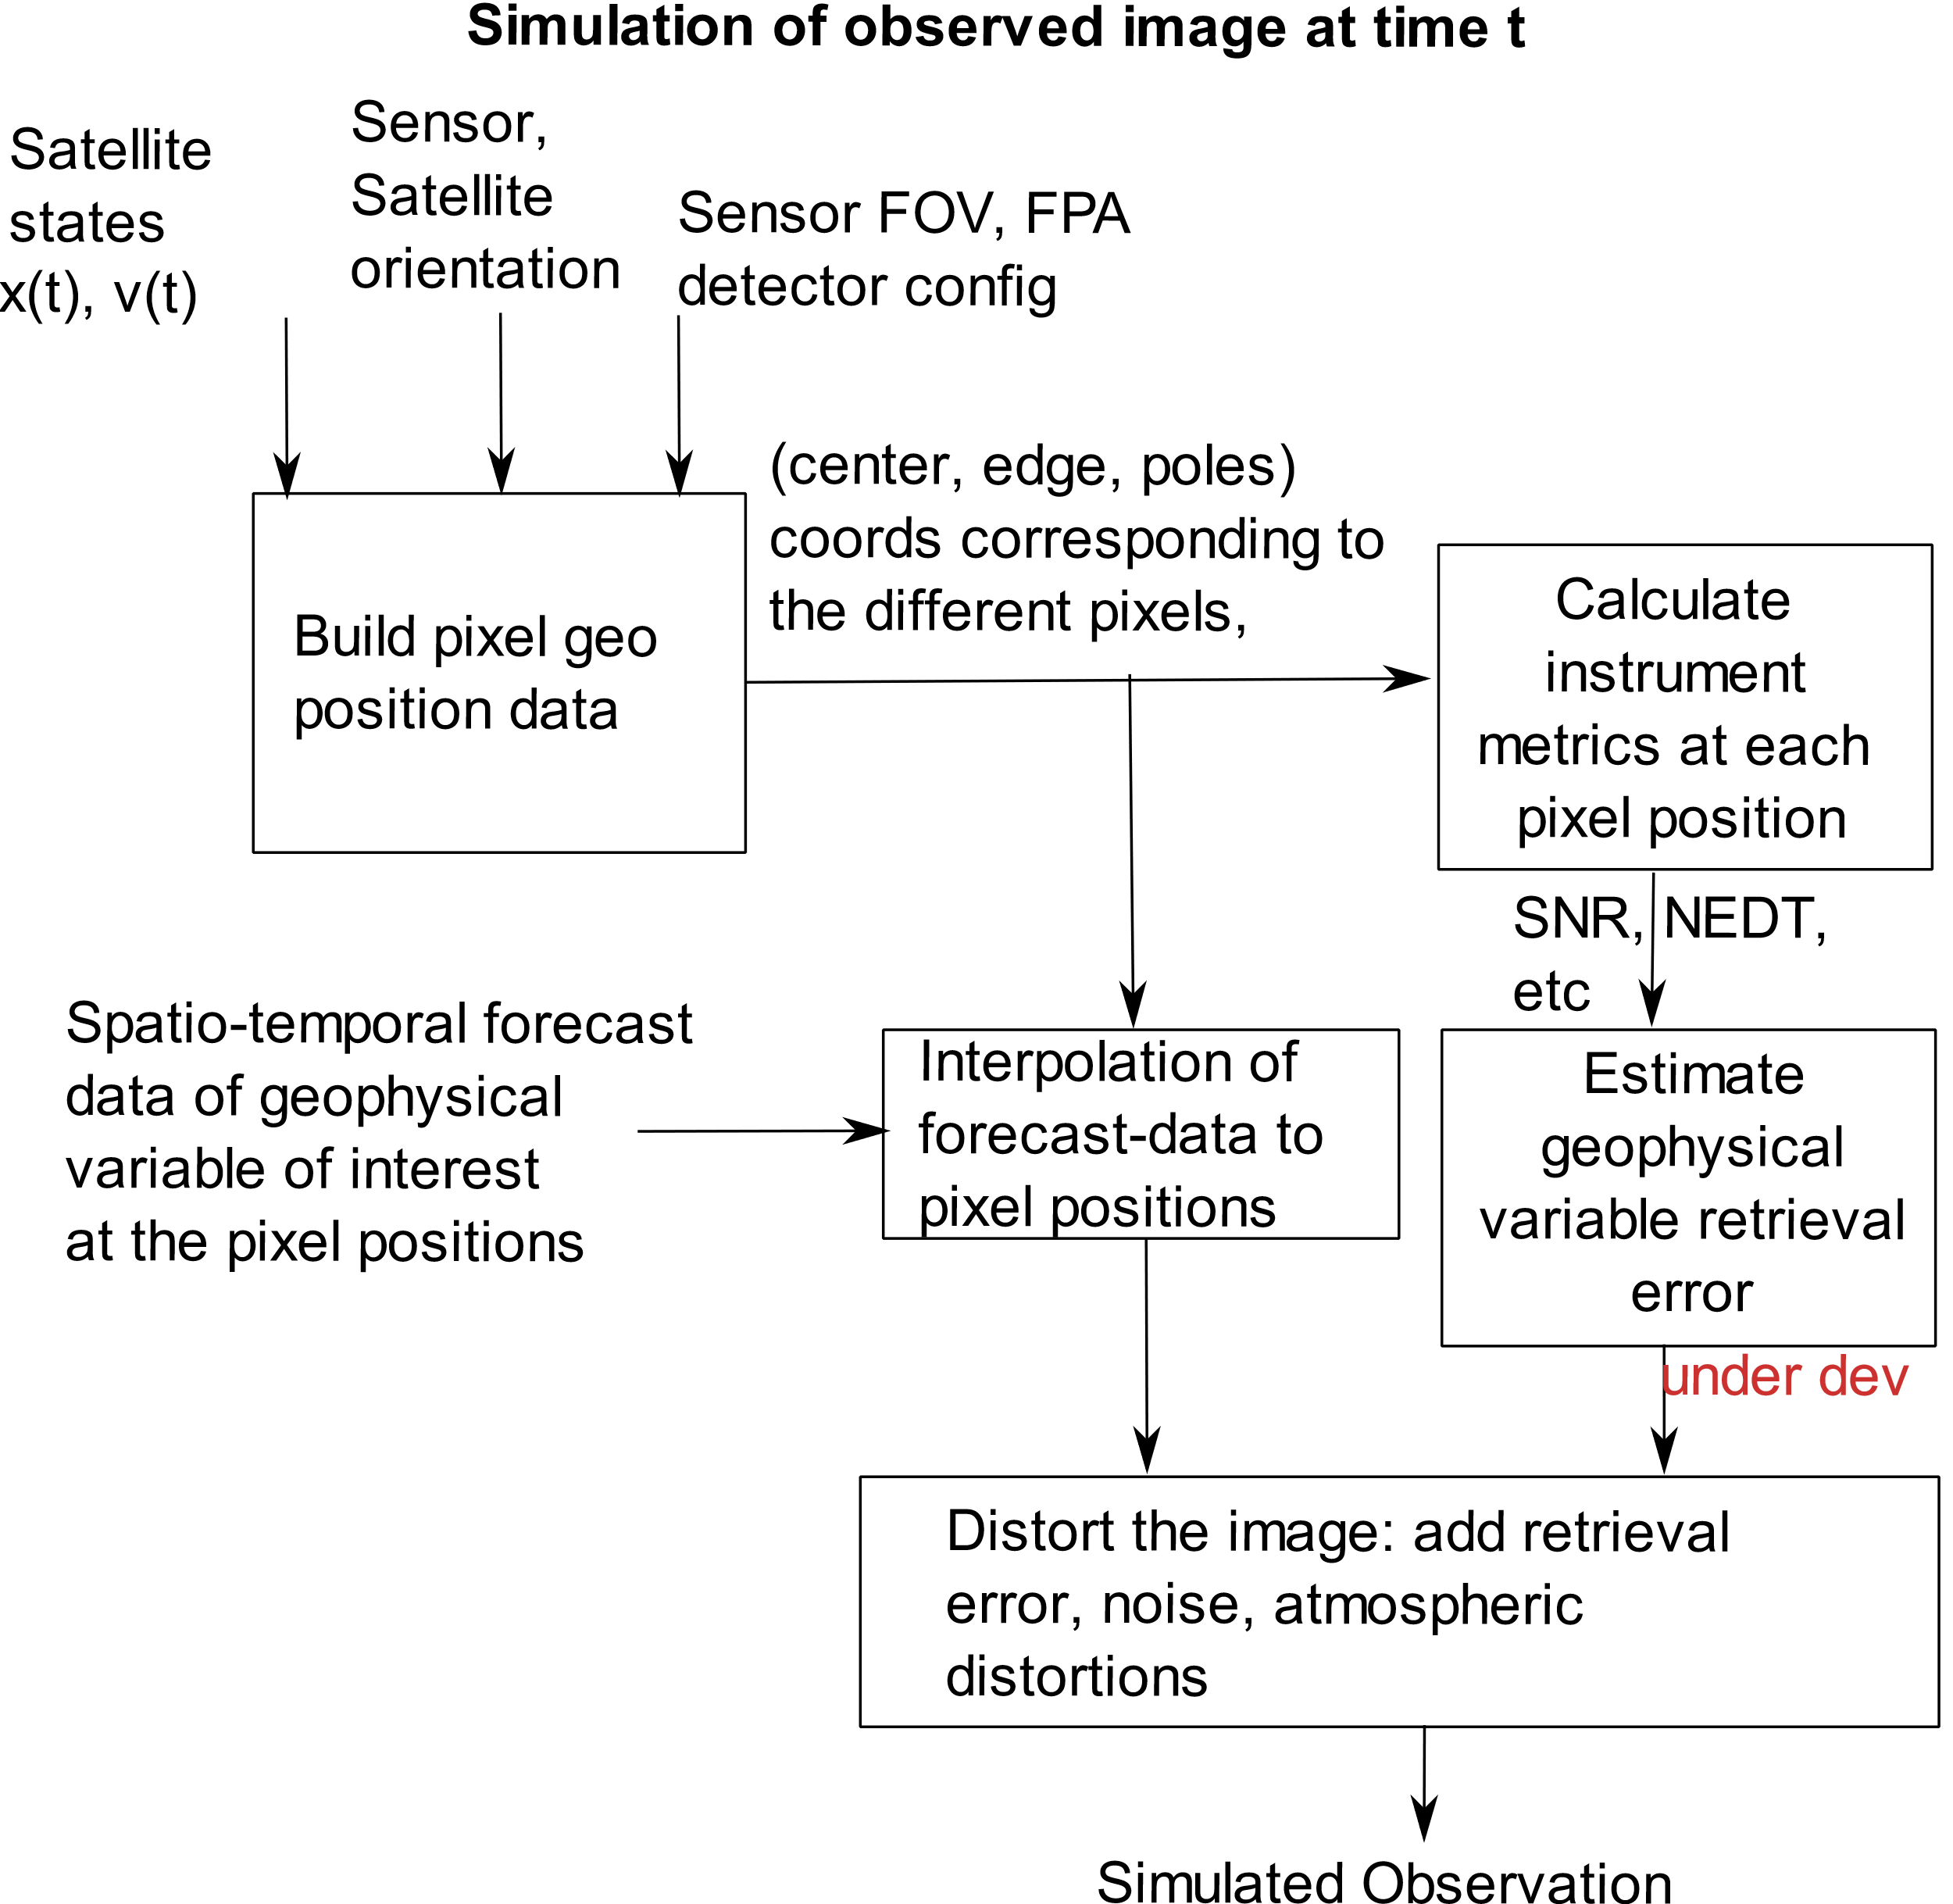
FEATURES: Synthetic Satellite Imagery
Synthetic imagery can be used to test out science-models and observation systems. How is it done?
Orbital propagation to determine position of satellite.
Project the sensor Focal-Plane Array (FPA) onto the Earth and determine the ground-pixel positions, shape.
Use of NWP model data as truth-data.
Interpolate to pixel positions and distort according to instrument and retrieval algorithm characteristics (under dev).
Output is closest to that of the Level-2 data product of an instrument.
Existing similar framework (with limitations): European Centre for Medium-Range Weather Forecasts (ECMWF) framework used to simulate future images from existing satellites. https://confluence.ecmwf.int//display/FCST/Simulated+satellite+data

Slide 12
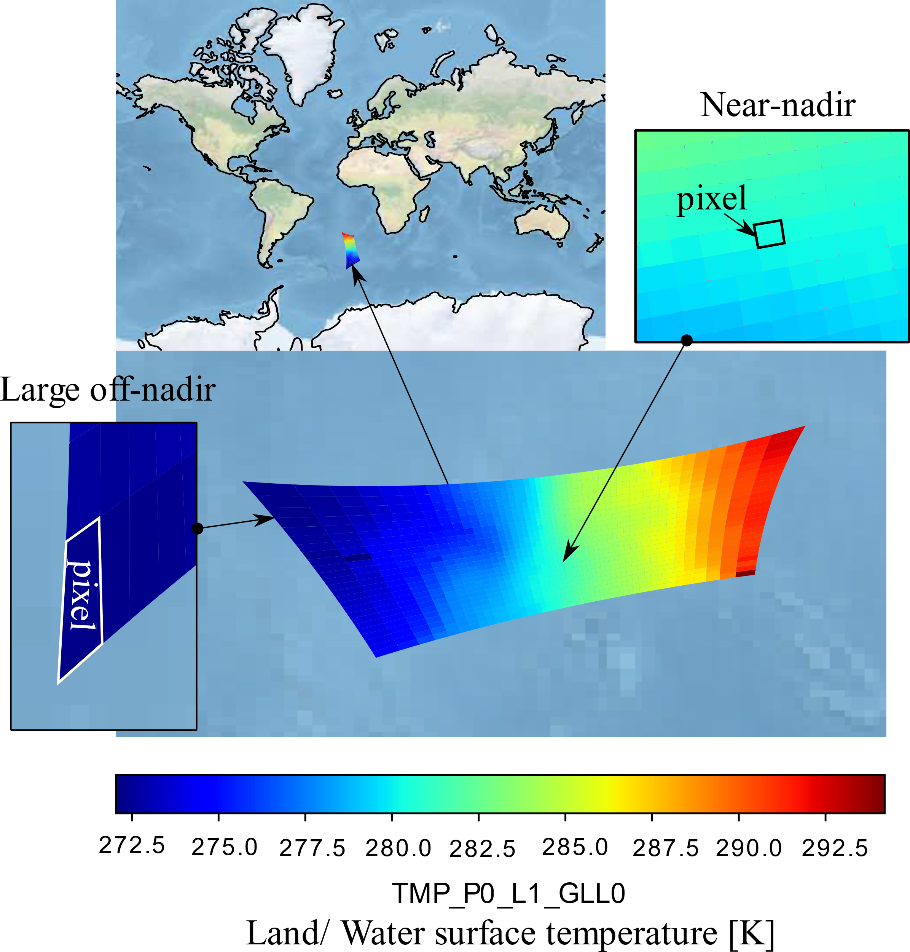
FEATURES: Simulated Satellite Imagery
Example of simulated imagery of instrument observing the surface temperature.
The simulation is of a satellite at 500km SSO making observation at 10deg off-nadir using an instrument with field of view 60 deg along-track and 120 deg cross-track.
The non-homogeneity of the pixel shapes can be seen.
Future Work:
Translate the instrument observation metrics to corresponding geo-physical retrieval errors and then incorporate them onto the synthetic imagery.
Extending the pixel-projection concept to line-scanners.

Slide 13
FEATURES: Source code
Built with Python, C++, JS with the support of third-party permissive open-source software such as:
Tkinter: GUI framework, CartoPy: Map projections
MetPy: Calculations on weather data
CesiumJS: 3D Geodata visualization
and many more….
Uses part of the NASA GMAT C++ source files (gmatutil folder) as an external library to access several orbit-dynamic related algorithms.
Common interface style to the python objects available in the OrbitPy and InstruPy packages. Most objects can be initialized from dictionaries or JSON strings. Inline code documentation is available and HTML documentation is under development on readthedocs platform.
https://orbitpy.readthedocs.io/en/latest/
https://instrupy.readthedocs.io/en/latest/index.html

Slide 14
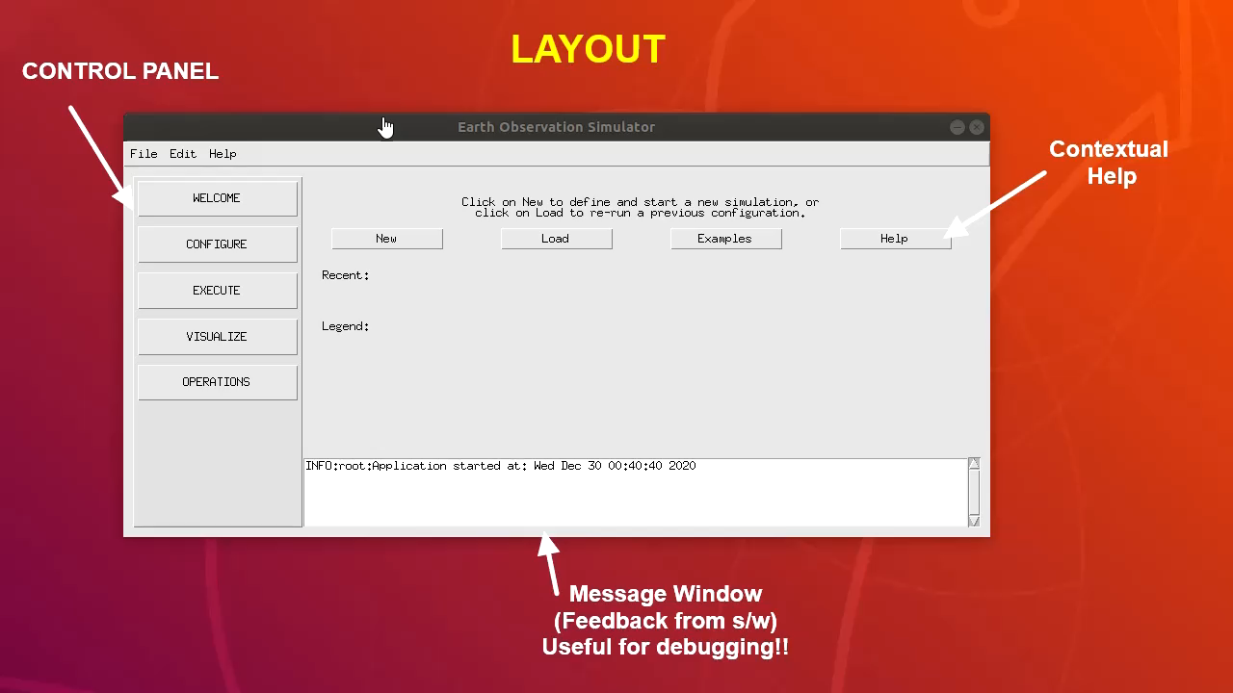
DEMO

Slide 15
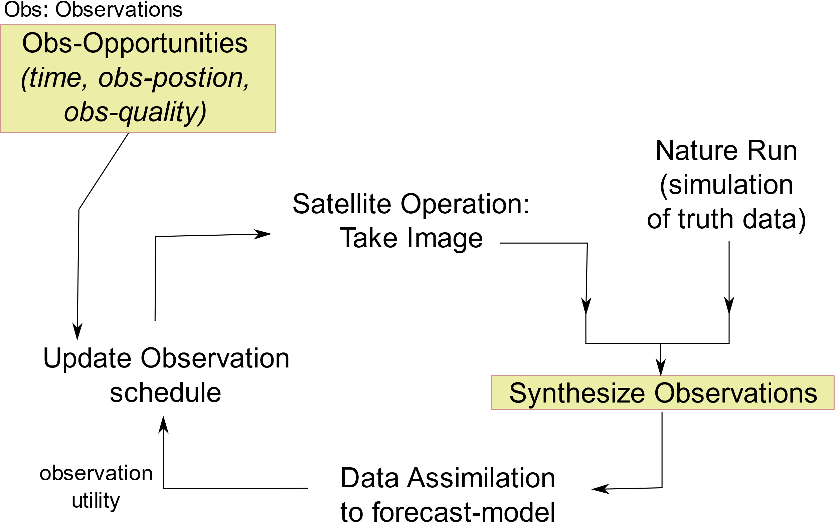
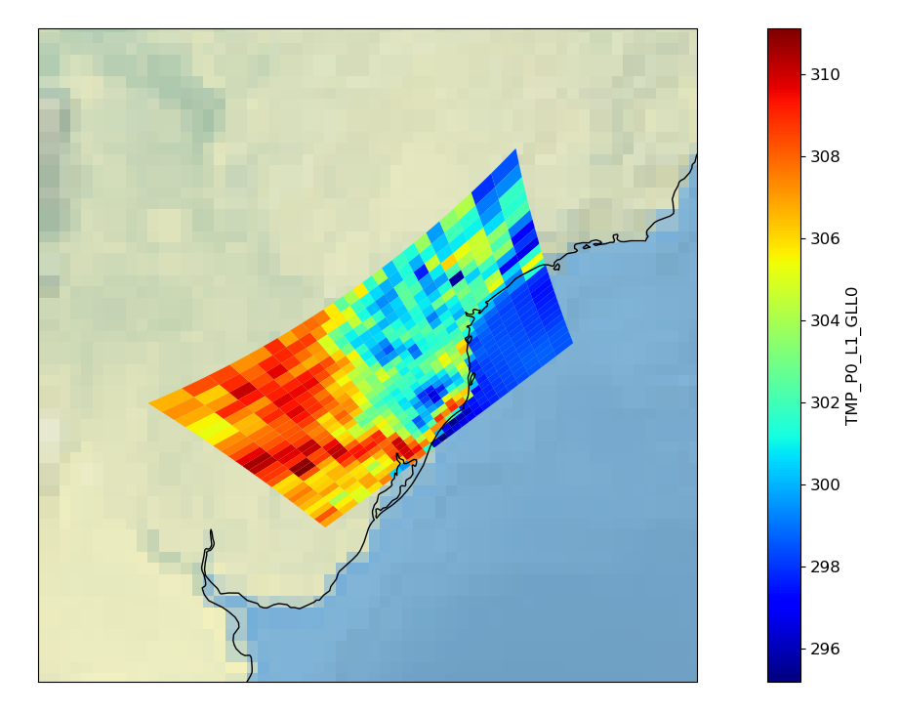
APPLICATIONS
The satellite orbit, coverage and observation metrics data collectively can be termed as set of observation opportunities which can be given to a planner to determine the observation schedule.
The synthesized observations can be fed back to the science models to close the loop in simulations of adaptive sensing.
Simulation of instrument data of instruments not yet been built. This helps scientists to start evaluating the simulated data in science models to determine their usefulness.
Testing of adaptive sensing algorithms
Simulated imagery in development of new instrument concepts involving observations at wide-range of off-nadir pointing.

Slide 16
FUTURE WORK
What we have introduced in this work is a software tool to enable and support design of observing systems.
Including a satellite solar-power generation model.
Extending concept of simulated imagery to line-scanning instruments (stripmap radars, pushbroom sensors) and inclusion of retrieval error in the synthetic images.
Currently the collection of python packages are undergoing extensive code refactoring. Expect to release a beta-version by October 2021.
To access the demonstrated features please use the following combination of releases: orbitpy v-0.1-alpha, instrupy v0.2-alpha and EOSim v0.1-alpha.
Reach out to vinay.ravindra@nasa.gov for support in use of the tool.
References:
V. Ravindra and S. Nag, "Instrument Data Metrics Evaluator for Tradespace Analysis of Earth Observing Constellations," 2020 IEEE Aerospace Conference, 2020, pp. 1-20.
V. Ravindra and S. Nag, "Fast Methods of Coverage Evaluation for Tradespace Analysis of Constellations," in IEEE Journal of Selected Topics in Applied Earth Observations and Remote Sensing, vol. 13, pp. 89-101, 2020.

